Slide 1
Best Control Mechanism for Humanoid Robot: PaLM-E
Sunzid Hassan

Slide 2
Humanoid Robot
Robot manipulation: Bring me the rice chips from the drawers.
Task and motion planning: Grasp the yellow block and place it on top of the blue block.
Visual Question Answering (VQA):
Humanoid robots mimic physical and functional properties of humans. These properties include –
Sensing | Inference | Control
Visual perception. | Robot initiative. | Navigation.
Auditory perception. | Question and answering. | Robot manipulation.
 | Planning.
 | Physical prediction.
 | Chain-of-thought.

Slide 3
PaLM-E
An embedded Large Language Model (LLM) system for robots.
Robotics at Google, Google Research.
Capable of sensing, inference, and control planning.
540B parameters of LLM PaLM + 22B Vision Transformer = 562B parameters.
State-of-the-art performance on OK-VQA.

Slide 4
Model Training
Visual transformers in PrefixLM Vision-Language Model: prefix images before the input sentence, decoder then predicts the continuation of the textual sequence.
PaLM-E: inject continuous, embodied observations such as –
text,
images,
state estimates,
other sensor modalities
into the language embedding space of a pre-trained language model.
This is realized by encoding the continuous observations into a sequence of vectors with the same dimension as the embedding space of the language tokens.

Slide 5
Model Input
The inputs to PaLM-E consist of text and (multiple) continuous observations.
The multimodal tokens corresponding to these observations are interleaved with the text to form multi-modal sentences.

Slide 6
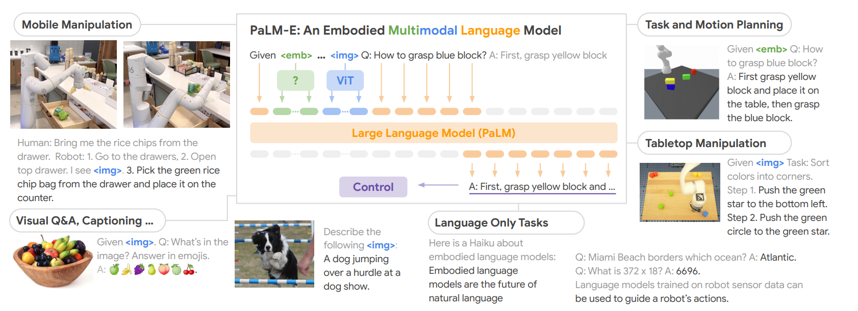
Example of a multi-modal sentence
Q: What happened between <img_1> and <img_2>? where <img_i> represents an embedding of an image.

Slide 7
Output of PaLM-E
The output of PaLM-E is text generated by the model, which could be –
an answer to a question,
or a sequence of decisions produced by PaLM-E in textual form that should be executed by a robot.
When PaLM-E is tasked with producing decisions or plans, it’s assumed that there exists a low-level policy or planner that can translate these decisions into low-level actions.

Slide 8
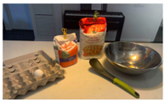
Humanoid visual perception, dialogue and planning
Perception and dialogue:
Input: I am a robot operating in a kitchen. Given <img>, what do I see?
Output: a bowl of eggs, a bowl of flour, a bowl of sugar, a spatula, a spoon, a bag of flour, a bag of sugar.
Planning:
Input: (context) When a human asks me to do a task, I will respond with the sequence of actions I would do to accomplish the task with only the items I see. Human: Use all of the ingredients you see to make a cake batter.
Output: 1. crack egg, 2. put egg in bowl, 3. put flour in bowl, 4. put sugar in bowl, 5. mix, 6. put in pan, 7. bake, 8. eat, 9. clean up.

Slide 9
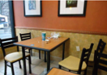
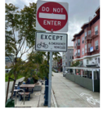
Humanoid inference
Robot initiative:
Input: Given <img>. Q: if a robot wanted to be useful here, what steps should it take?
Output: clean table, pick up trash, pick up chairs, wipe chairs, put chairs down.
Zero-shot multimodal chain-of-thoughts:
Input: Given <img>. Q: Can I go down this street on a bicycle?
Output: 1. do not enter, 2. except bicycles, 3. do not enter except bicycles, 4. yes.

Slide 10

Humanoid Control
Robot manipulation:
Input: bring me the rice chips from the drawer.
Output: 1. go to the drawer, 2. open top drawer, I see <img>. 3. pick the green rice chip bag from the drawer and place it on the counter.
Tabletop manipulation:
Input: given <img> Task: sort colors into corners.
Output: 1. push the green star to bottom left. 2. push the green circle to the green star…

Slide 11
Thank you!
Reference: Driess, D., Xia, F., Sajjadi, M. S., Lynch, C., Chowdhery, A., Ichter, B., ... & Florence, P. (2023). Palm-e: An embodied multimodal language model. arXiv preprint arXiv:2303.03378.

